Slide 1



Q3 Safety Meeting
2023

Slide 2
Agenda
Administrative Updates
Customer Updates
Refreshers for Fall/Winter
New Updates
Growth

Slide 3
Administrative Updates
Paperwork on Mondays
  No Paperwork, no check.
  Only for what was done for the week before unless otherwise approved.
Fuel Cards
  Lost/No receipt, take picture and send to Dillon or Whitney.
Work uniform
  Presentable at all times.
  No athletic shorts, sweatpants, PJ’s.
  No tank tops.
  Abide by customer requirements.
Time Off
  Employee Portal
  Website short form
  1 week in advanced
Maintenance Reports
  Website Jotform
  Due monthly
Truck Problems
  Let Dillon know as soon as possible.

Slide 4
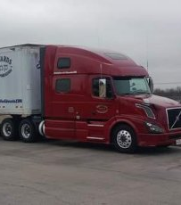
Customer Updates
New Customers
Existing Customers
Rinker
Cameron Ashley
Oldcastle Tulia
Georgia Pacific
Boise Cascade

Slide 5



New Customers
Rinker Pipe
Seasonal / Inconsistent
Load Numbers sent at Pickup
Mostly Round Trip
4:30am – 5pm Load times
Oldcastle Lawn & Garden - Tulia
New Facility
Short Runs Mostly
Cameron Ashley
Seasonal / Inconsistent
App use required with each load
Typically, last minute & Weekends
Very Slow in the Fall

Slide 6
Cameron Ashley App
See handouts for directions
  Everyone has unique log in.
Keep handout in your truck book.
Only update Pickup and delivery status. Take picture of main page & upload at each stop.

Slide 7
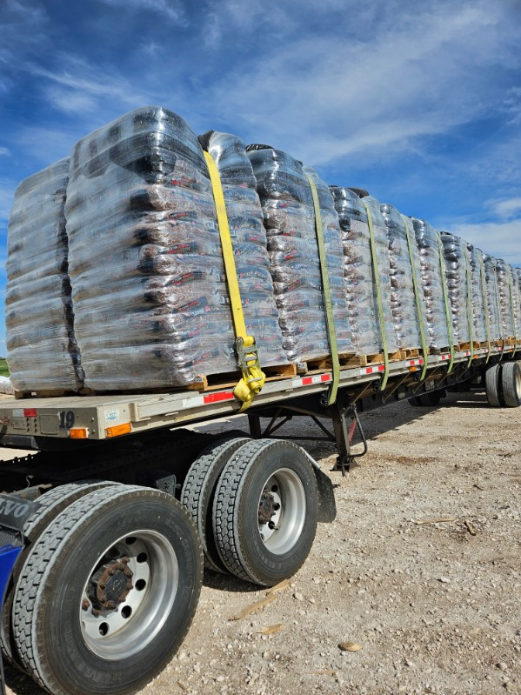
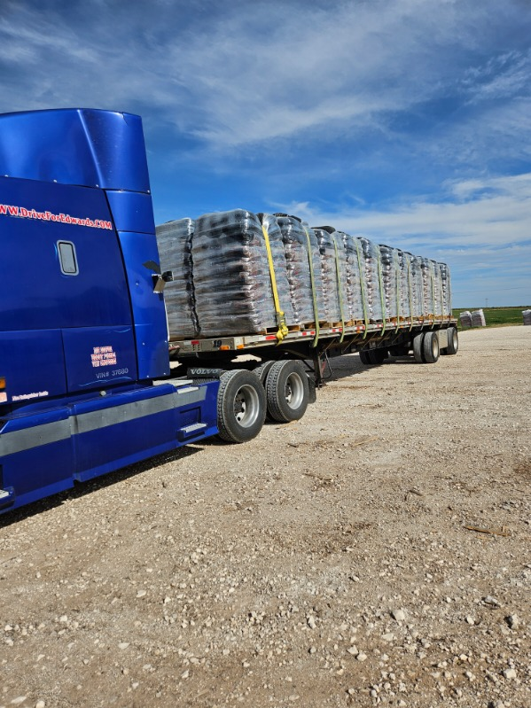
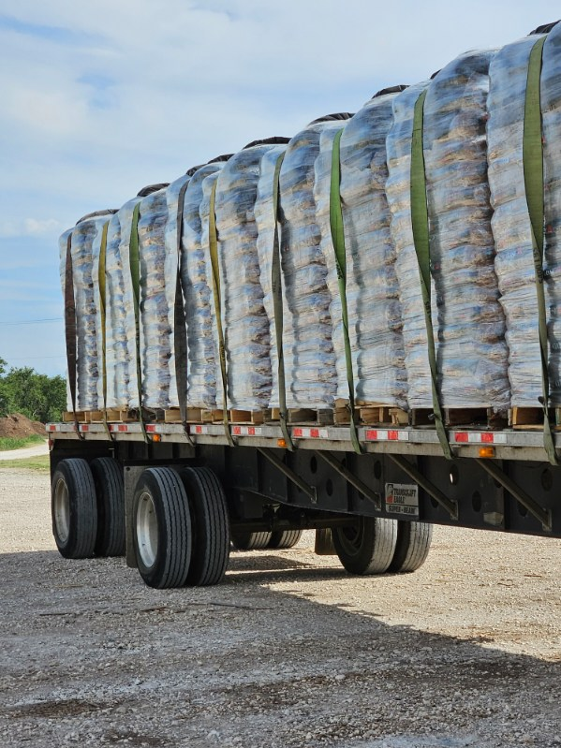
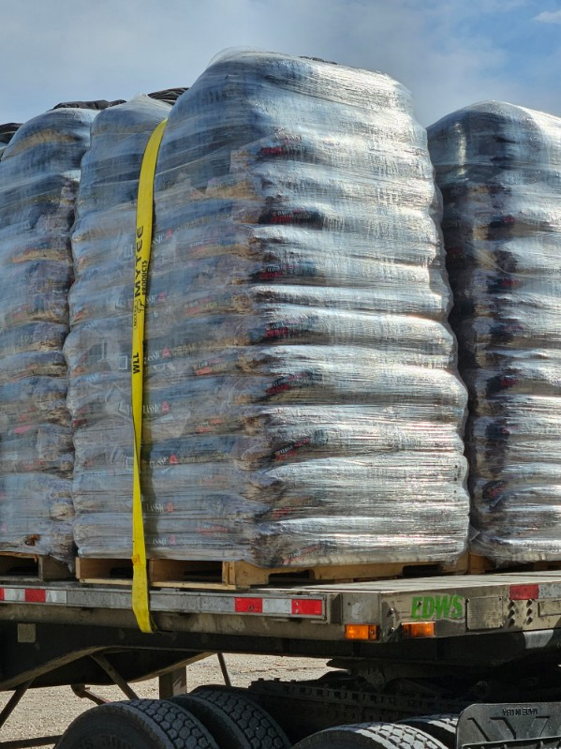
Oldcastle - Tulia
V Boards
Light Weight
Quick Loading
Full Trailer Loads

Slide 8
Oldcastle - Tulia
V Boards
Light Weight
Quick Loading
Full Trailer Loads

Slide 9



Existing Customers
Updates
Georgia Pacific
Plant Codes
Load and Check in times
New Plant
Real Time Updates
Boise Cascade – Dallas Ops
Load Times
Expectations
Action Gypsum - CPU
CPU Consistency picking up
US Gypsum
GP Plants
American Gypsum – Duke, OK

Slide 10

Action Gypsum - CPU
Consistency Increasing
Pickup Locations
  GP - Sweetwater
  USG – Sweetwater
    Self Strapping Available
  American Gypsum – Duke, OK
Other Locations
  CertainTeed – Arlington
    Must Tarp
  BASF – Lancaster
    V-boards or Tarp
More Loads coming soon

Slide 11
Boise Cascade – Dallas Ops
Duncanville
  6-3:30 PM load times.
  Night Loading not always an option.
  Corner Protectors on ALL loads
  Double Check load Weight
  Loading Times
    Let me know when you check in
    Let me know if no activity in 45min.
Lancaster
  Trailer Inspection Report with each Dry Van load.
  ALL load updates sent to Dillon. Not John.

Slide 12
Georgia Pacific Sweetwater
West Plant (414)
East Plant (204)
Allowed in @ 6am.
Check in 7am.
Cut off @ 4pm.
Allowed in @ 6am.
Check in 7am.
Cut off @ 4pm.
SWT-DALLAS (Lowes)
East Plant
D# 204001243
PO# 5064430001
If load is a customer pickup, it will have the company followed by “CPU”.
Exp. (Action CPU)

Slide 13
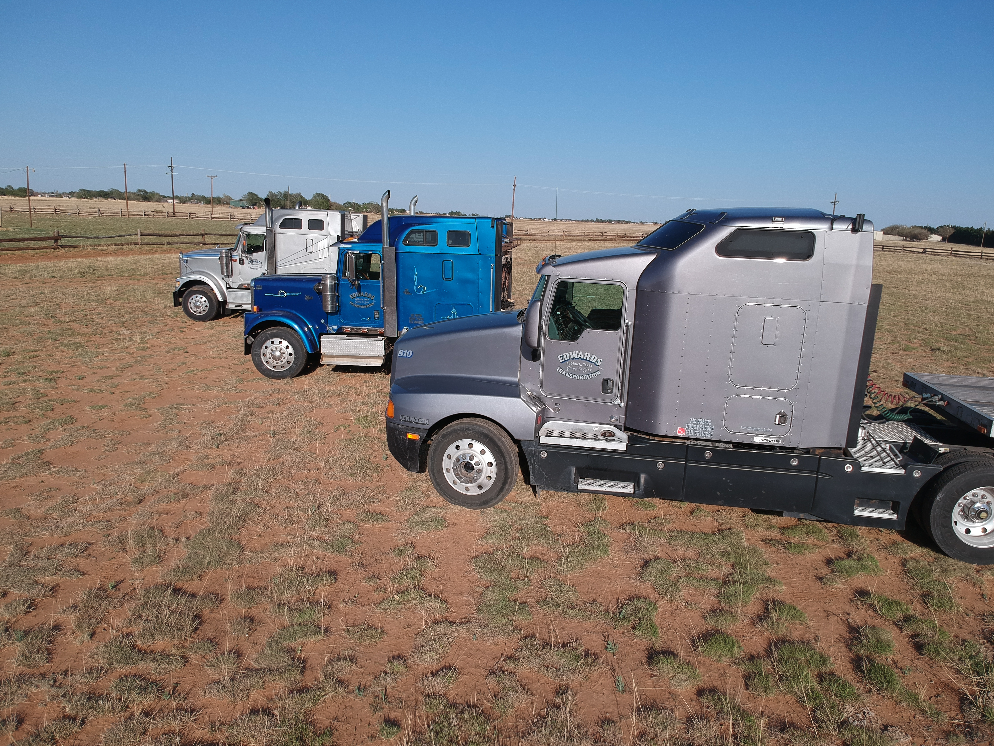
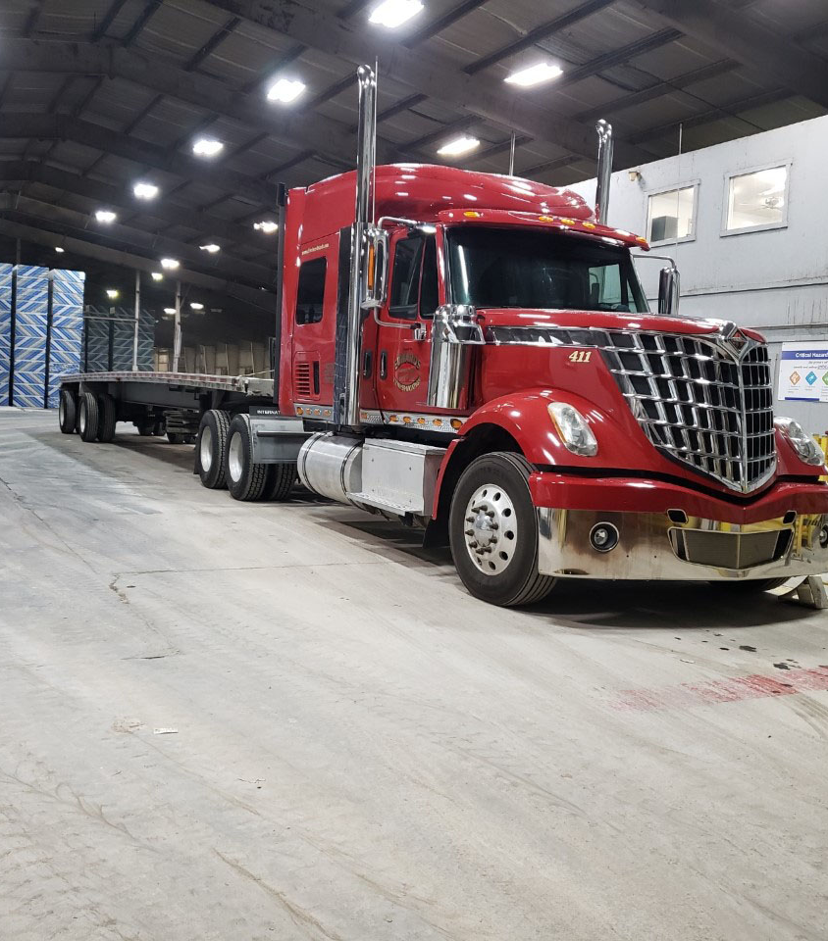
Operations Refreshers
Check in 10am daily
After 5pm, if it is not an emergency or need to know, wait till next day
Stay professional with each other and with customers
Safety Refreshers
Strapping
  2 straps 1st 4 feet.
Log Books up to date at all times
Tarping
Fall/Winter Weather Outlook
RTS App
  Use only at RTS locations
13

Slide 14
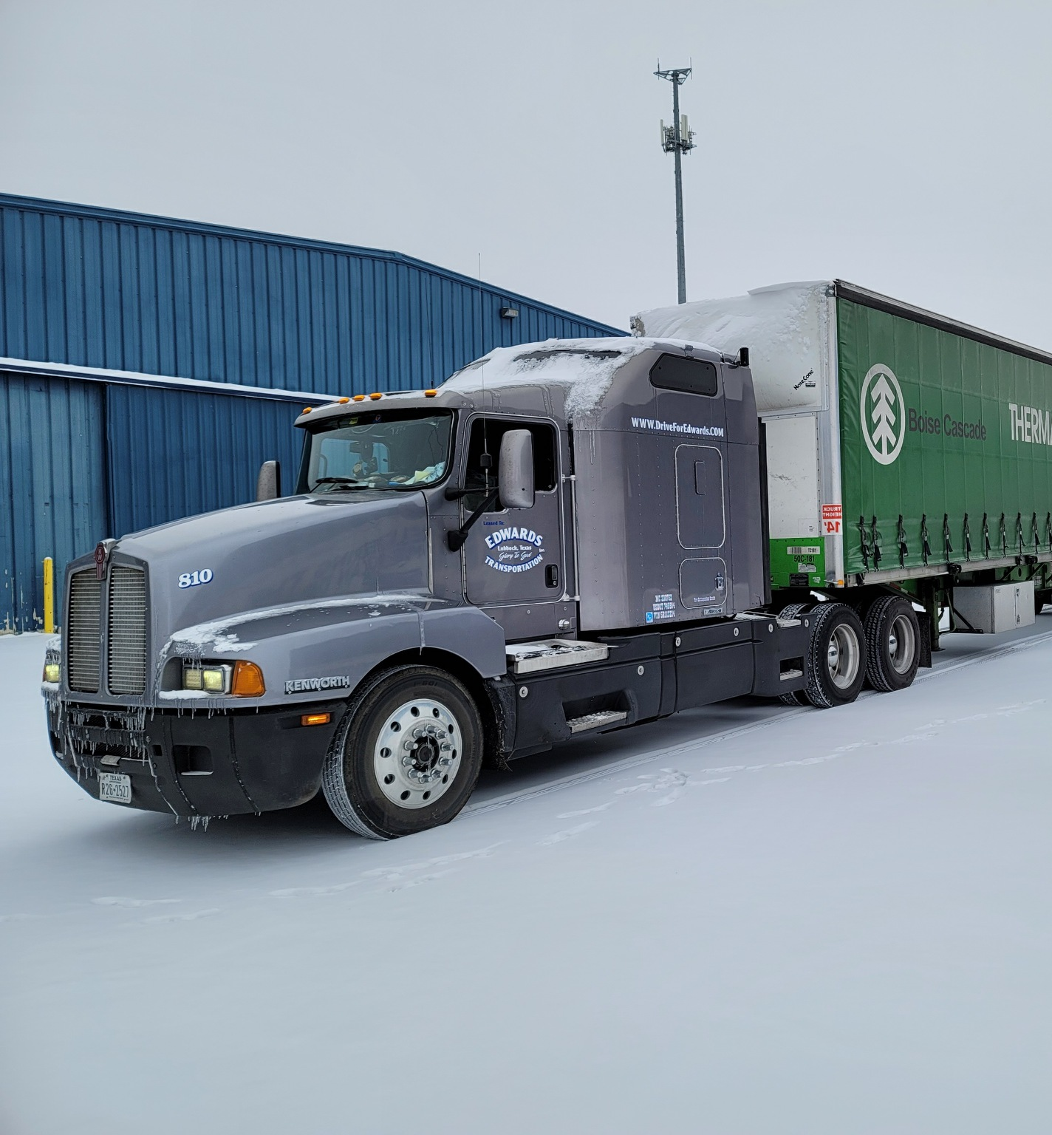
Questions?
14

Slide 15
“A good tree produces good fruit, and a bad tree produces bad fruit. A good tree can’t produce bad fruit, and a bad tree can’t produce good fruit.{ } Just as you can identify a tree by its fruit, so you can identify people by their actions.”
Matthew 7:17-20
15

Slide 16

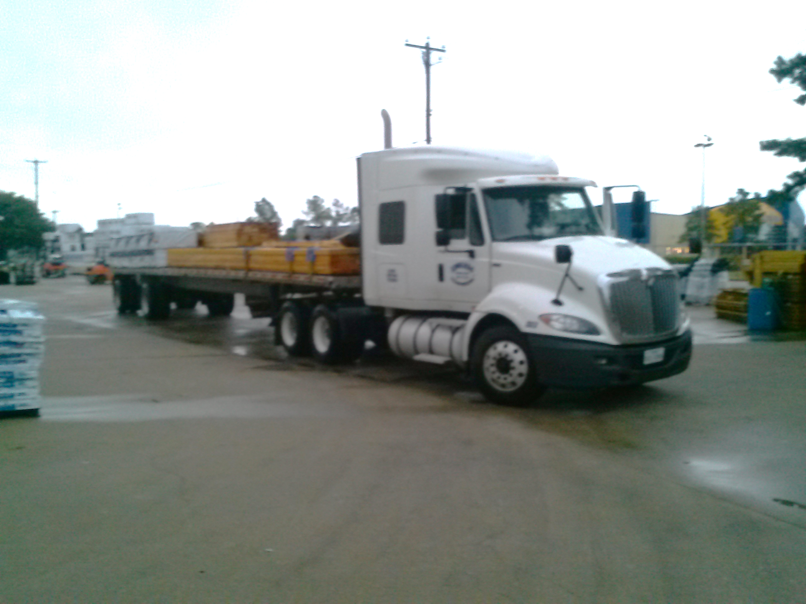


See Dillon Before Leaving
Richard
Jerry
Robert

