Slide 1

Q2 Safety Meeting
June 2023

Slide 2





Agenda
Refresh
Customer Updates
Georgia Pacific
CPU Shipments
Boise Cascade
Rinker Pipe
Cameron Ashley
American Lumber
Yard Directions
New Changes
Referral
Inspections
Closing
Summary
Questions and Answers

Slide 3
Refreshers
Check in by 10AM
Text is better than call in most cases.
“Checking in” NOT acceptable
Let Dillon deal with problems
Wait Times

Slide 4

Georgia Pacific
Opens 5:45am
Begin loading 7am
Safety Meeting 8-9am
Stop loading 5pm STRICT
NO MORE MOVING LOADS
YOUR responsibility to make it on time

Slide 5
Customer Pickup Shipments
Action Gypsum
Cowtown
ISC
Pay Change
Pickup from GP and USG plants in SWT
Pickup from Duke & Fletcher OK
Pickup from McQueeny

Slide 6

DUNCAVILLE / BRONZE WAY
Begin loading 6:30 AM
SAFETY MEETING 8-9AM
Stop loading 4pm STRICT
NO MOVING LOADS
Let dispatch know if stop taken off
Let dispatch know when fully delivered
Night Loading available AS NEEDED

Slide 7

LANCASTER DOOR SHOP
Loads pre-loaded
Pay CLOSE attention to paperwork.
Send pics of trailer if in Edwards Dry Van.
  54327 (53 ft) & 54320 (48 ft)
If damaged or refused or missing product, alert dispatch BEFORE leaving location
DO NOT LEAVE if delivery location will not unload you. Let dispatch know and wait for info.
SWEEP OUT EDWARDS DRY VANS UPON RETURN TO LANCASTER!
New Trailer Inspection Forms req for now.

Slide 8

Formerly
Forterra
Open at 5:30 am
Start loading soon after
Dunnage Required
Strap Only

Slide 9
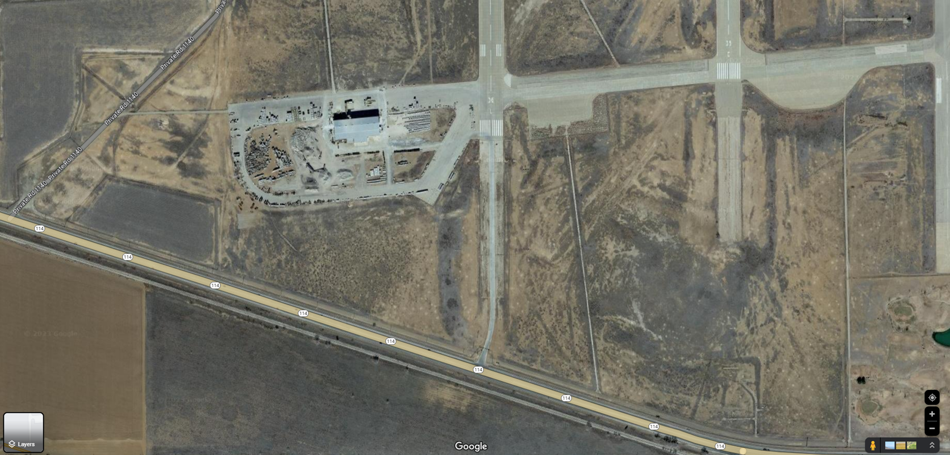




Slide 10

Cameron Ashley Building Products
New Customer
Power Only
  Curtain Side Trailers (Similar to Boise Lancaster)
  Simple loads
  Trailer Inspection Report w/ each load
Flatbed Work
Saturday Deliveries Occasional
Lubbock yard

Slide 11
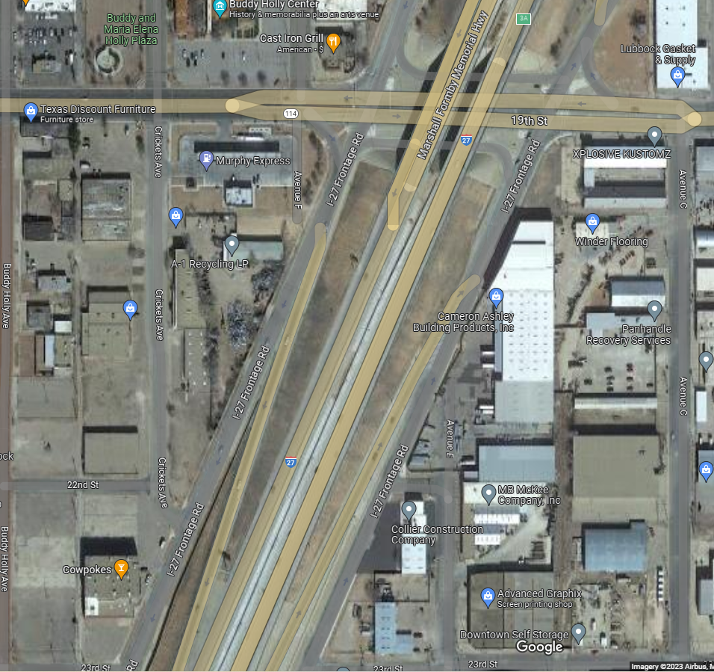




Slide 12
General Updates
Working on new Local pickups
Tarps are required for some shipments.
YOUR responsibility to protect and care for load.
Alert dispatch if delivery takes more than 45 min.
Alert dispatch to any damage to load before leaving plants
Market updates
TRAILERS
  Greased and washed regularly
  Update dispatch about damage
  No holes in trailers
TRUCKS
  Kept clean and washed
  Big Rig – Tye
  McWhorter Tire - Lubbock
  All Star – Lubbock
  Blue Beacon

Slide 13
Holiday Schedule
4th of July
  Closed 3rd & 4th
LET DILLON KNOW TODAY OF ANY UPCOMING TIME OFF

Slide 14
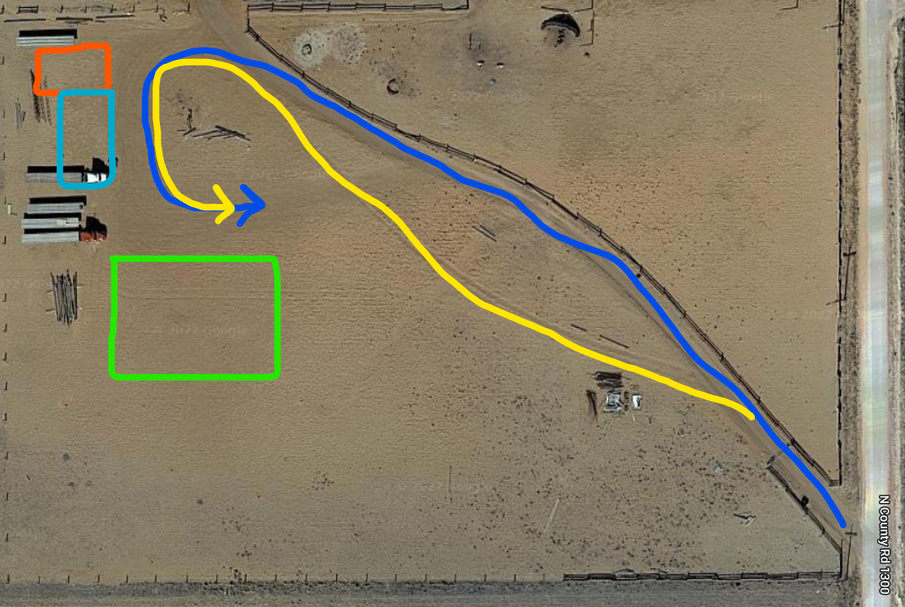
Edwards Yard
MAX SPEED 25 MPH on road. | MAX SPEED 5 MPH in yard. | Park in designated spots.

Slide 15
Bonus Updates
Referrals (30 day & 90 day)
  $30
  $100
DOT inspections Sticker $100
Randoms $25

Slide 16
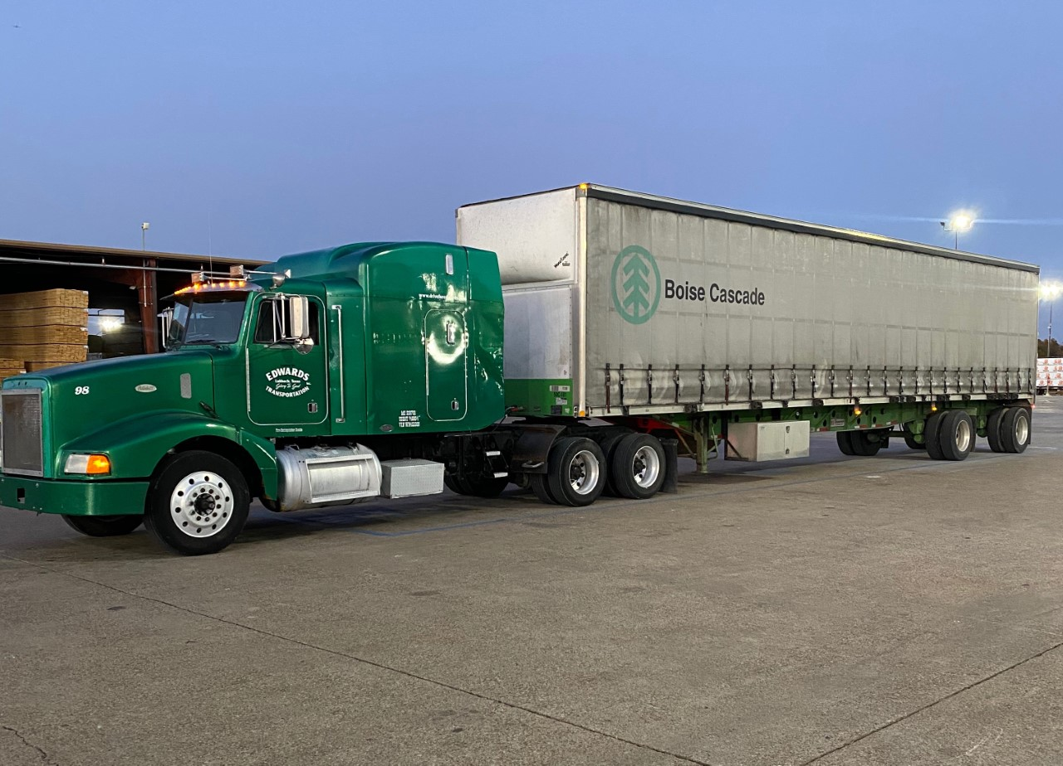
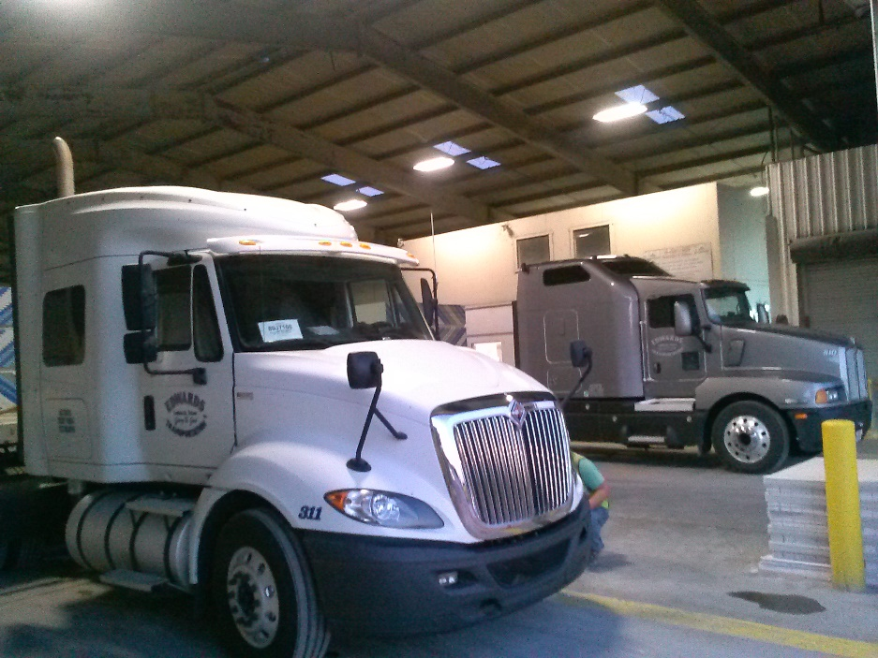
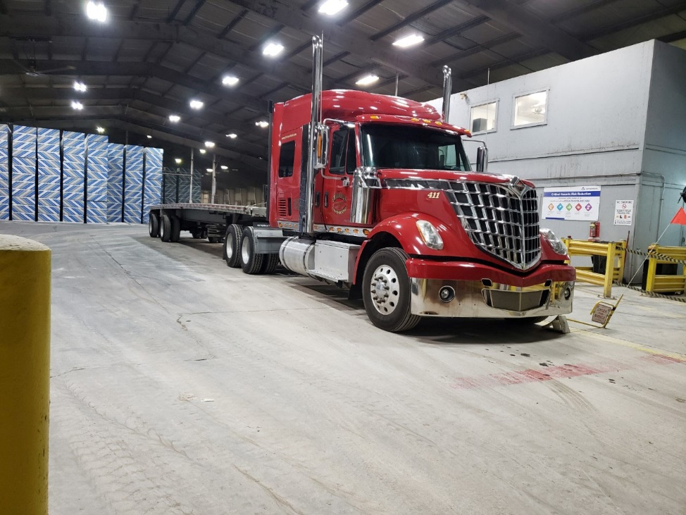
Website Updates
Vacation Pics | Truck Pics | Destination Pics

Slide 17
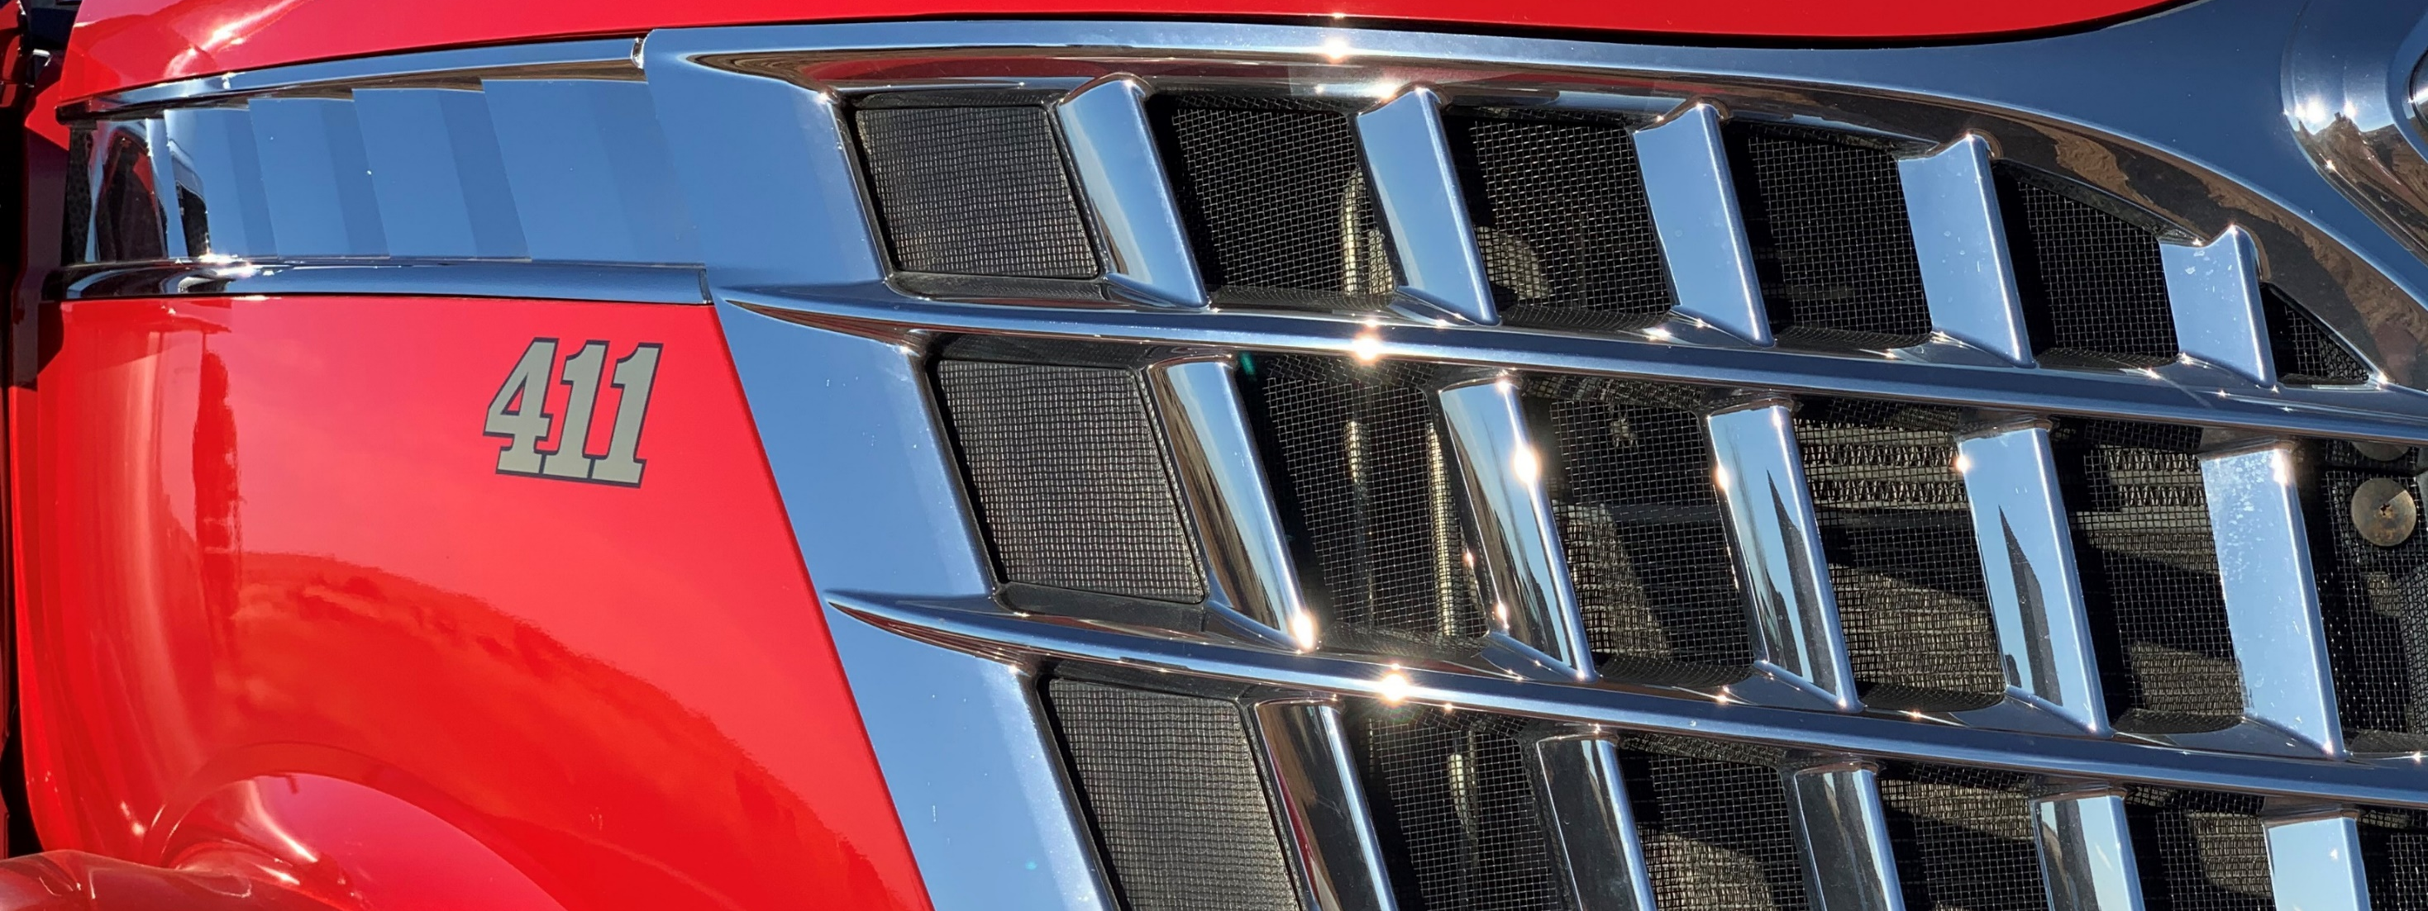
Wrap Up
Questions?

Slide 18
See Dillon Before Leaving
Robert
Justin

